Slide 1

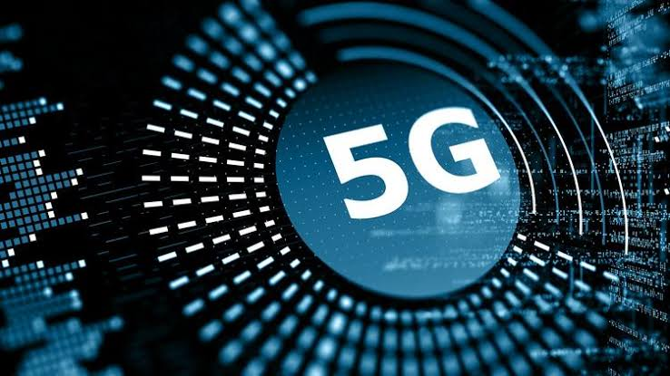

5G NETWORK

Slide 2
Course Title : Computer Network Presented by: Moniruzzaman (IT-18007) Mst.Zakia Sultana (IT-18027) Dept : ICT

Slide 3
Questions:
What is 5G network?
Who Created 5G technology?
What will enable 5G network?
What new is offered by the 5G applications and devices?
What are the major components of 5G technology?
How does 5G work?
What are the differences between the previous generations of mobile networks and 5G?
Will 5G work on 4G Phones or Devices?
How and when will 5G affect the global economy?
How fast is 5G?
Is 5G available now?
What are the disadvantages of 5G technology?
Which countries have 5G network?

Slide 4
What is 5G network?
5G is the 5th generation mobile network. It is a new global wireless standard after 1G, 2G, 3G, and 4G networks. 5G enables a new kind of network that is designed to connect virtually everyone and everything together including machines, objects, and devices.
5G wireless technology is meant to deliver higher multi-Gbps peak data speeds ,ultra low latency, more reliability, massive network capacity, increased availability, and a more uniform user experience to more users. Higher performance and improved efficiency empower new user experiences and connects new industries.

Slide 5
Who created 5G technology?
AT&T had deployed 5G in 21 cities and claimed the 5G network would be deployed in 30 states by the end of 2019. The 5G standards are being jointly developed by the International Telecommunication Union (ITU) and 3GPP. The standard written by the ITU called the IMT-2020.

Slide 6
What will enable 5G network?
5G will enable instantaneous connectivity to billions of devices , the Internet of Things (IoT) and a truly connected world. 5G will provide the speed, low latency and connectivity to enable a new generation of applications, services and business opportunities that have not been seen before.

Slide 7
What new is offered by 5G application?
It is expected that 5G will offer mobile internet speeds of more than 10 gigabits per second (Gbps), approximately a hundred times faster than 4G.
The latency will be less than a millisecond with 5G network

Slide 8
What are the major components of 5G technology?
For ultra fast mobile broadband, low latency and ultra reliable network to support all future applications, existing technologies have many limitations. 5G will be using new network terminologies, high bandwidth spectrum, complex modulation schemes and algorithms with advanced hardware modules.

Slide 9
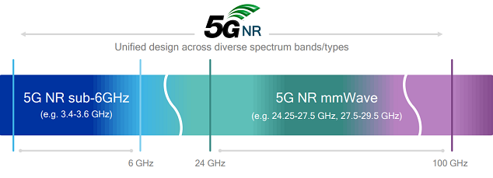
What are the major components of 5G technology?
Spectrum – 5G NR:
5G New Radio is a new spectrum that will be utilized in 5G applications to support much higher data rate. Millimeter wave spectrum from 24 GHz to 90 GHz and unlicensed sub-6GHz spectrum will be used in first generation of 5G deployments of mobile broadband.

Slide 10
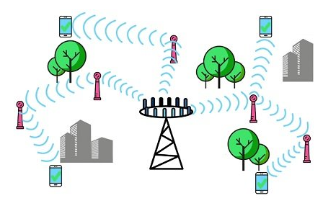
What are the major components of 5G technology?
Small cells and pico-cells:
Small cells are low power base stations used in LTE advanced versions and 5G technology to power devices in a smaller geographical area like few hundred meters up to 2 KM radius. Smalls cells will be using millimeter waves to transmit and receive data. Millimeter waves are not suitable for long distance communication due to higher distortion from atmosphere and obstacles.

Slide 11
How does 5G work?
Initially integrate 5G networks with existing 4G networks to provide a continuous connection. A mobile network has two main components, the ‘Radio Access Network’ and the ‘Core Network:
The Radio Access Network :
The Radio Access Network consists of various types of facilities including small cells, towers, masts and dedicated in-building and home systems that connect mobile users and wireless devices to the main core network.
The Core Network :
The core Network is the mobile exchange and data network that manages all of the mobile voice, data and internet connections. For 5G, the ‘core network’ is being redesigned to better integrate with the internet and cloud based services and also includes distributed servers across the network improving response times (reducing latency).

Slide 12
What are the differences between the previous generations of mobile networks and 5G?
The previous generations of mobile networks are 1G, 2G, 3G, and 4G.
First generation - 1G 1980s: 1G delivered analog voice.
Second generation - 2G Early 1990s: 2G introduced digital voice (e.g. CDMA- Code Division Multiple Access).
Third generation - 3G Early 2000s: 3G brought mobile data (e.g. CDMA2000).
Fourth generation - 4G LTE 2010s: 4G LTE ushered in the era of mobile broadband.
1G, 2G, 3G, and 4G all led to 5G, which is designed to provide more connectivity than was ever available before.
5G is a unified, more capable air interface. It has been designed with an extended capacity to enable next-generation user experiences, empower new deployment models and deliver new services.

Slide 13
Will 5G work on 4G phone or devices?
Yes. If we are among the 86 percent of the population who are concerned that the recent rollouts of 5G networks will make your 4G cell phone obsolete, there's no need to worry. 4G phones still work on a 5G network, they just won't get that coveted 5G speed.

Slide 14
How and when will 5G affect the global economy?
5G is driving global growth.
• $13.2 Trillion dollars of global economic output • 22.3 Million new jobs created • $2.1 Trillion dollars in GDP growth
Through a landmark 5G Economy study, we found that 5G’s full economic effect will likely be realized across the globe by 2035—supporting a wide range of industries and potentially enabling up to $13.2 trillion worth of goods and services.
This impact is much greater than previous network generations. The development requirements of the new 5G network are also expanding beyond the traditional mobile networking players to industries such as the automotive industry.

Slide 15
How fast is 5G?
5G is designed to deliver peak data rates up to 20 Gbps based on IMT-2020 requirements. Qualcomm Technologies’ flagship 5G solutions, the Qualcomm® Snapdragon™ X55 and Snapdragon X60 Modem-RF Systems, are designed to achieve up to 7.5 Gbps in downlink peak data rates.
But 5G is about more than just how fast it is. In addition to higher peak data rates, 5G is designed to provide much more network capacity by expanding into new spectrum, such as mmWave.

Slide 16
How fast is 5G?
5G can also deliver much lower latency for a more immediate response and can provide an overall more uniform user experience so that the data rates stay consistently high—even when users are moving around. And the new 5G NR mobile network is backed up by a Gigabit LTE coverage foundation, which can provide ubiquitous Gigabit-class connectivity.

Slide 17
Is 5G available now?
Yes, 5G is already here today, and global operators started launching new 5G networks in early 2019. In 2020, many countries expect nationwide 5G mobile networks. Also, all major Android phone manufacturers are commercializing 5G phones. And soon, even more people may be able to access 5G.

Slide 18
What are the disadvantages of 5G technology?
Obstructions can impact connectivity. The range of 5G connectivity is not great as the frequency waves are only able to travel a short distance.
Initial costs for rollout are high. ...
Limitations of rural access. ...
Battery drain on devices. ...
Upload speeds don't match download speeds. ...
Detracting from the aesthetics.

Slide 19
Which countries have 5G network?
South Korea , China and the United states are the countries that lead the world in building and deploying 5G technology.

Slide 20
Thanks....

